Slide 1

GO Team Business Meeting #2
West Manor Elementary School

Slide 2
Agenda
Call to Order
Roll Call; Establish Quorum
Action Items (add items as needed)
Approval of Agenda
Approval of Previous Minutes
Discussion Items 2025-2030 Strategic Plan Development
Facilities Master Plan Update
Additional Discussion Item (if needed):
Information Items (add items as needed)
Principal’s Report
Announcements
Public Comment Adjournment

Slide 3
Action items
Approval of Agenda
Approval of Previous Minutes

Slide 4
Discussion items

Slide 5
2025-2030 School Strategic Plan Development

Slide 6
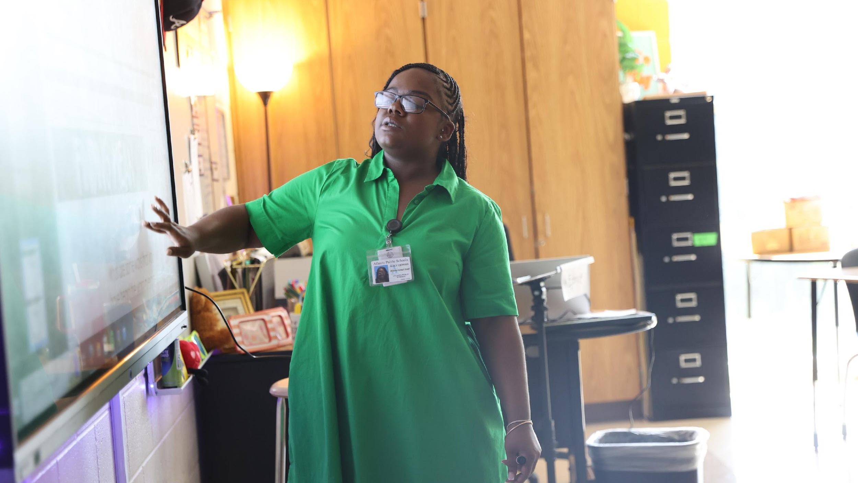

Atlanta Public Schools
2025-2030 Strategic Plan
One District. One Goal. Every Child.

Slide 7


We are Atlanta’s Public School System
To educate and empower Atlanta’s students to shape the future

Slide 8


A COMMUNITY OF BELIEVERS GETTING BACK TO BASICS
Our Strength is Our Team
Atlanta’s students will have effective and engaged teachers, leaders, and staff.
Increase concentration of highly-effective teachers and leaders
Prioritize engagement and retention for staff
Grow and promote strong teachers, leaders, and staff
Our Responsibility Is Shared
Atlanta’s students will have supportive families, communities, and partners.
Build meaningful partnerships
Expand Atlanta Partners for Education (APFE) impact
Increase access and engagement for families and communities
Our System Is Efficient & Effective
Atlanta’s students will have the schools and resources they need to succeed.
Maximize facility usage for the student and community good
Leverage data to drive strategic financial investments
Implement sustainability initiatives
We Are Strengthening Our Instructional Core
Atlanta’s students will have high-quality instruction, materials, and targeted support.
Implement high-quality, relevant, and engaging instructional materials and professional learning in all core content areas
Target resources towards subgroups (eg. exceptional education, English learners, economically-disadvantaged)
Accelerate early learning
We Are Caring For Every Child
Atlanta’s students will have trusted, supportive adults meeting their unique needs.
Expand strategies that reduce chronic absenteeism and disproportionate discipline
Implement systematic culture and climate strategies
Increase student access to trusted and reliable adults (eg. mentors, coaches, counselors)
We Are Sparking Student Curiosity
Atlanta’s students will have access to explore and expand their passions and interests.
Promote robust arts, athletics, world language, and enrichment offerings
Expand access to high-interest and workforce-ready offerings (e.g. career programs and pathways, advanced coursework)
Explore specialized and innovative school models (eg. School of the Arts)

Slide 9
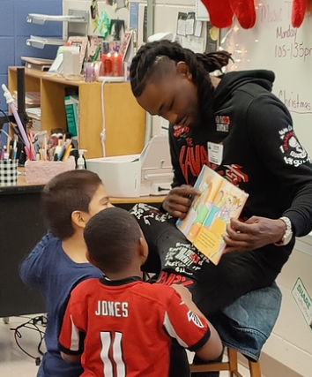
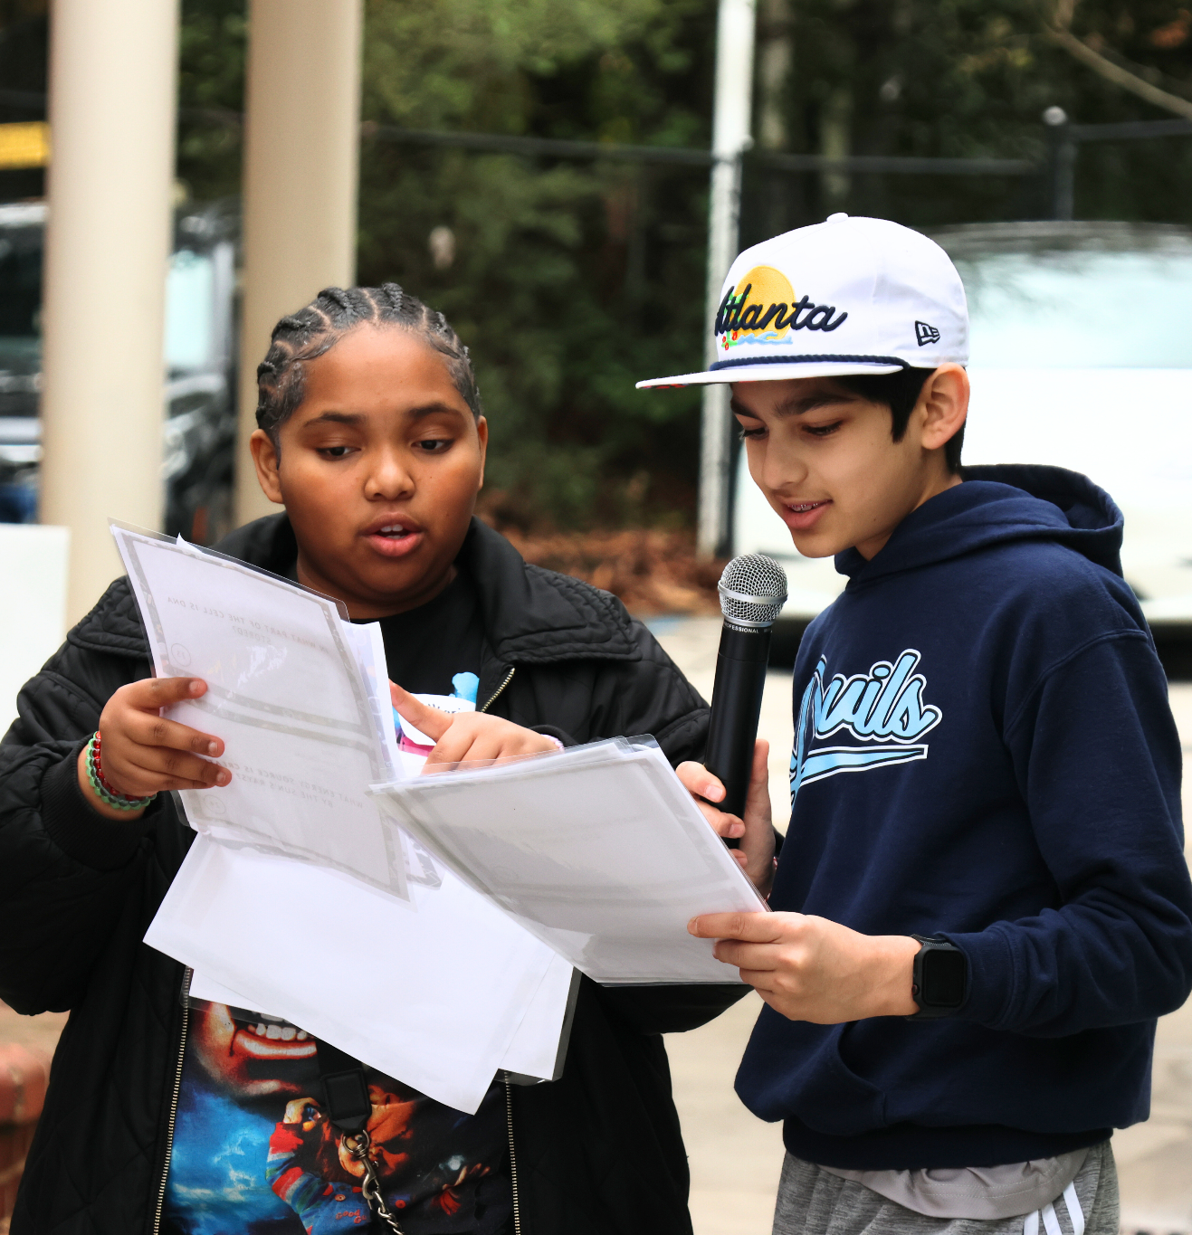

Goals and Key Performance Indicators
Focus Area:
We Are Caring For Every Child
1
By 2030, we will increase the percentage of 3rd grade students scoring proficient or above in ELA (GA Milestones) by 20 percentage points.
Actual (2025)
Light pink: 2024
Target (2030)
68.8% | Absenteeism % of students who are not chronically absent* | 80%
60% | Sense of Belonging % students who feel a sense of belonging* | 75%
89.6% | Discipline: All Students % of all students without suspensions (OSS) * | 95%
83.5% | Discipline: Students with Disabilities % of Students with Disabilities students without suspensions (OSS)* | 95%
86.4% | Discipline: Black Students % of Black students without suspensions (OSS)* | 95%
56% | Student-Staff Relationships % of students feeling comfortable going to most or all of the adults in the school for help* | 75%
0% | Student Success Plans % of students with individual success plans | 90%
19% | School Climate % of schools with 4 or 5 star climate rating* | 50%
2
By 2030, we will increase the percentage of 8th grade students scoring proficient or above in Math (GA Milestones) by 20 percentage points.
3
By 2030, we will increase the percentage of students meeting at least one CCRPI College and Career Readiness Indicator by 20 percentage points.
* Includes Charter and Partner Schools

Slide 10
GO Team School Strategic Plan Development
One District. One Goal. Every Child.

Slide 11
School Strategic Planning Overview
Purpose: To cascade the district strategic plan to the school level, while grounding our focus in the school’s Continuous Improvement Plan. This will create alignment, reduce confusion, and simplify our efforts.
Timeline: Your school’s 2030 Strategic Goals and Objectives should be updated, approved and ranked by January 2026. Schools will focus on the strategies as part of FY27 Budget and Continuous Improvement Plan processes.

Slide 12
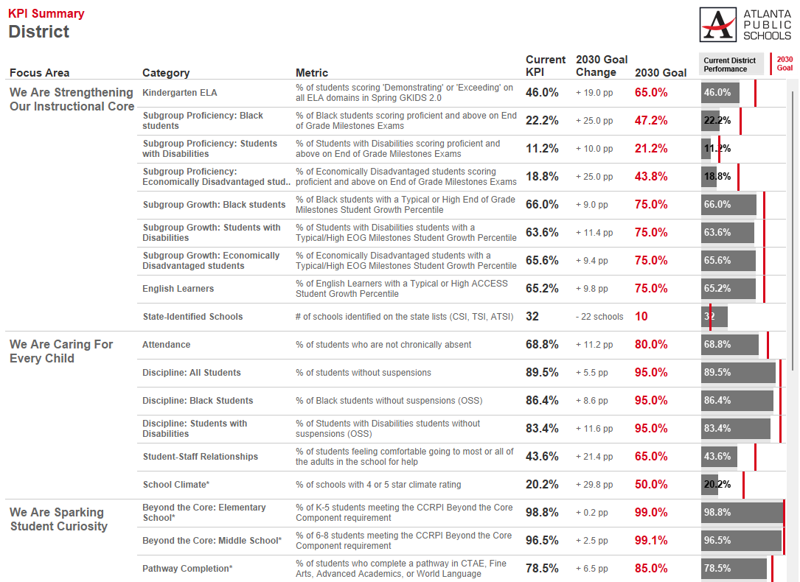
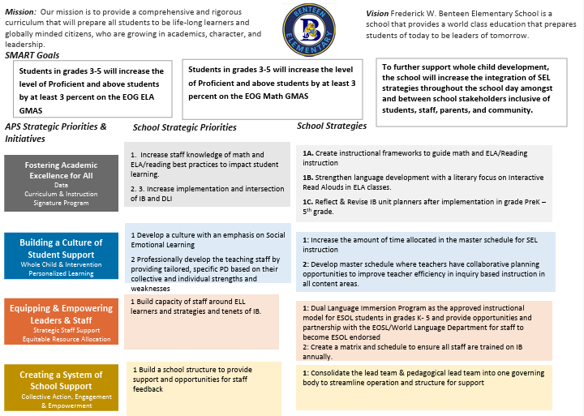
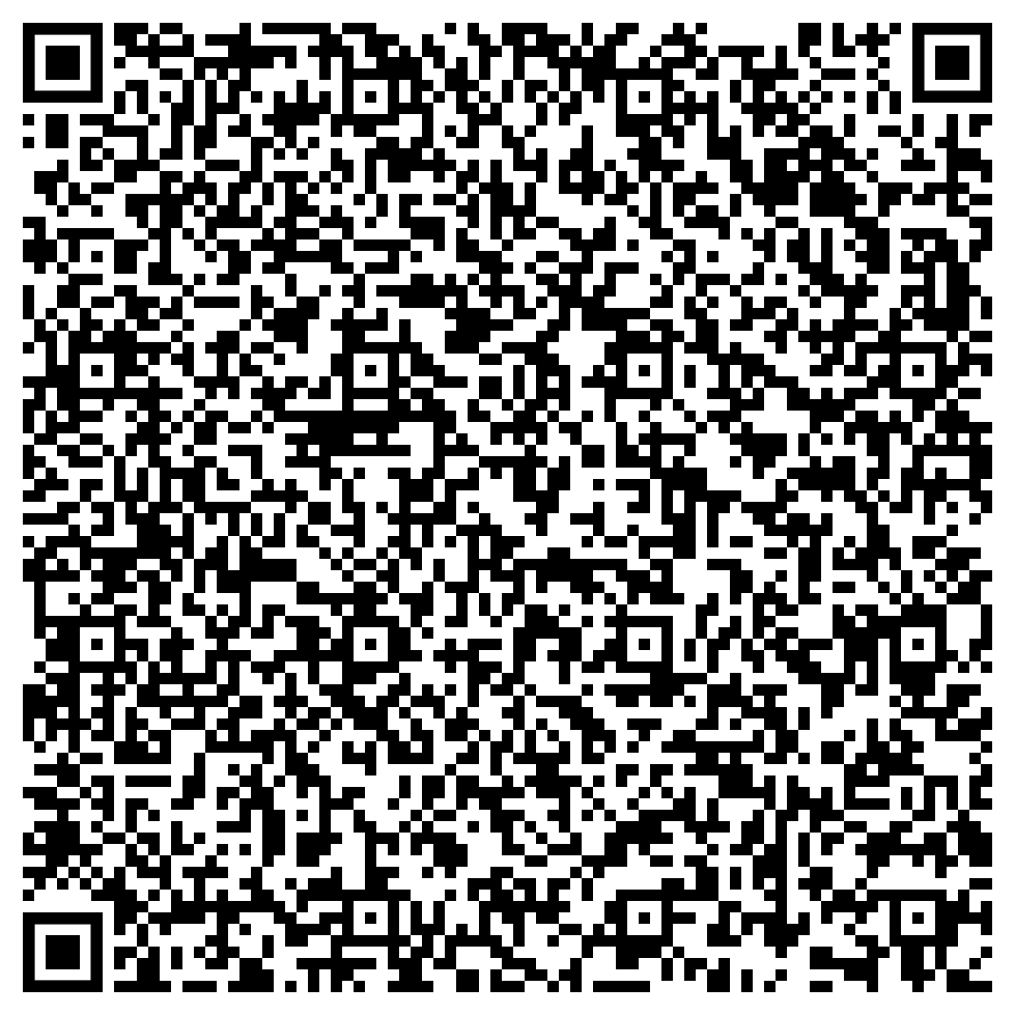
Three Key Resources to Review
1
2020-2025 School Strategic Plan
2
2025-2026 Continuous Improvement Plan Goals
3
School Data Sheet
https://tinyurl.com/SchoolDataSheets
By the end of the 2025 - 2026 school year, Benteen will increase the CCRPI Attendance by at least 6.6% points from 83.4% to 90%.
By the end of the 2025 - 2026 school years, Benteen will increase the percent of students scoring proficient and above on the GMAS assessments in math by 5%, from 35% to 40%. Benteen will decrease the percent of students scoring beginning on the GMAS assessment in math by 3%, from 38 to 35%.
By the end of the 2025 - 2026 school year, Benteen will increase the CCRPI Attendance by at least 6.6% points from 83.4% to 90%.
Use the QR code to access all school data sheets

Slide 13
School Strategic Planning Process
1
Review Data
Sample GO Team Business Meeting Cadence
Business Meeting 1:
Review Data (MAP, GMAS, Graduation Rate, CCRPI, etc.)
Business Meeting 2:
Review Data (School KPIs)
Align Mission/Vision/ Purpose
Confirm 2030 Goals
Business Meeting 3:
Identify 2025-2030 Strategic Objectives
Business Meeting 4 (Budget Allocation):
Confirm & Prioritize Your Strategic Plan
2
Align Mission/Vision/Purpose
3
Confirm 2030 Goals
Create CIP Goals to 2030
Identify Additional Goals
4
Identify 2025-2030 Strategic Objectives
Reflect on 2020-2025 Strategic Plan
Review and Discuss Additional Objectives Going Forward
5
Approve Your Strategic Plan & Rank Your Strategic Objectives for FY27

Slide 14

Today’s Focus: School Strategic Planning Process: Steps 1, 2, and 3
1
Sample GO Team Business Meeting Cadence
Business Meeting 1:
Review Data (MAP, GMAS, Graduation Rate, CCRPI, etc.)
Business Meeting 2:
Review Data (School KPIs)
Align Mission/Vision/ Purpose
Confirm 2030 Goals
Business Meeting 3:
Identify 2025-2030 Strategic Objectives
Business Meeting 4 (Budget Allocation):
Approve Your Strategic Plan & Rank Your Strategic Objectives for FY27
Review Data
2
Align Mission/Vision/Purpose
3
Confirm 2030 Goals
Create CIP Goals to 2030
Identify Additional Goals
4
Identify 2025-2030 Strategic Objectives
Reflect on 2020-2025 Strategic Plan
Review and Discuss Additional Objectives Going Forward
5
Approve Your Strategic Plan & Rank Your Strategic Objectives for FY27

Slide 15
Review Data
One District. One Goal. Every Child.

Slide 16
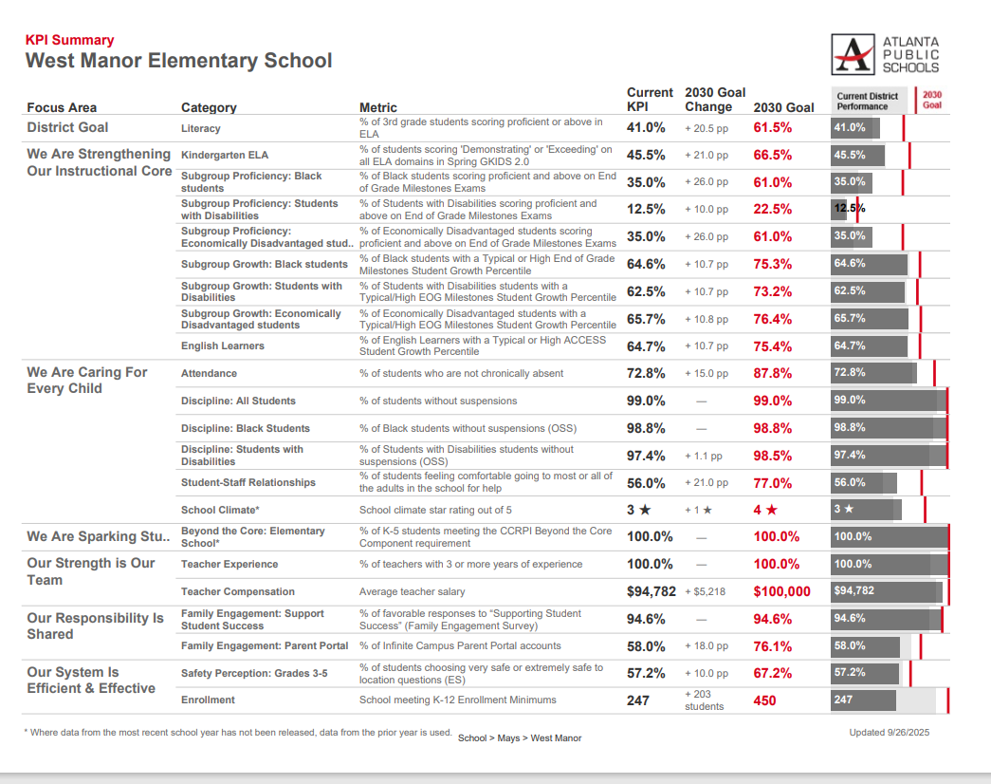
Guiding Questions for the GO Team to Discuss:
What do you notice?
What are your wonderings?
Are you on track?
Are there specific sub-group performance gaps?
Outside of the “Instructional Core,” what could be a focus area?
Notes:
Notes:
These are aligned to the district’s KPI’s
Before identifying missing data, review what is available on this dashboard for strategic importance.
Where data from SY25-26 has not been released, data from the prior year is used.
These are great examples of potential additions to your strategic goals.

Slide 17
2. Align Mission/Vision/Purpose
One District. One Goal. Every Child.

Slide 18
The MISSION
West Manor Elementary School commits to cultivating inquiring, knowledgeable and caring scholars who strive to think, act, and reflect with a value and understanding of multiple cultures, languages, and perceptions.
To this end, the school will work collaboratively with all stakeholders to meet the needs of all learners while providing a safe and supportive learning environment. The school implements a rigorous, inquiry-driven international curriculum which supports the development of socially, emotionally, and academically balanced lifelong learners who are committed to creating a more peaceful world through intercultural understanding and respect.
The VISION
The vision of West manor is to be a nurturing, comprehensive, and high performing school where faculty, staff, parents, and all stakeholders will concertedly prepare our students to become globally productive citizens and leaders.

Slide 19
West Manor IB World School
SMART Goals
During the 2025 school year we will Increase the number of students in grades 3-5 scoring proficient from 35 % to 40% on ELA Milestones
During the 2025 school year we will Increase the number of students in grades 3-5 scoring proficient from 32 % to 37% on Math Milestones
During the 2025 School year we will increase the number of students with 10 or less days absent from 74% to 80%
APS Strategic Priorities & Initiatives
School Strategic Priorities
School Strategies
Fostering Academic Excellence for All
Data
Curriculum & Instruction
Signature Program
1.
3.
1A. Implementation of an intervention block to reduce gaps in learning
1B. Employ a literacy block with phonics for grades k-2
1C. Create PLC planning time for teachers to internalize standards and plan for instruction
Increase student phonic awareness and create early readers
Increase student knowledge in numbers and operations domain
Increase student multiplication skills
Building a Culture of Student Support
Whole Child & Intervention
Personalized Learning
Increase student attendance and decrease suspension rate
TBD: Create an attendance team to monitor and address attendance concerns, Create a Care Team to address student needs
TBD: Utilize SLC practices and restorative justice with the Counselor to reduce suspensions
Equipping & Empowering Leaders & Staff
Strategic Staff Support
Equitable Resource Allocation
Increasing Teacher knowledge of Standards
Increase Teacher knowledge of IB Program
TBD: Monthly IB training for staff, Professional development individualized around teacher needs in reading and math, training for phonics program (Fundations)
Ongoing PD for SEL, restorative practices, and trauma
Creating a System of School Support
Collective Action, Engagement & Empowerment
TBD: Conduct data meetings in PLC, with parents and students. Students will also have goal setting meetings with teachers
--Increase Parent Liaison and Social Worker positions to full time to support the needs of students and parents
Improve stakeholder knowledge of school data and how to assist
Provide support to students and stakeholders in need

Slide 20

Proposed Updates to School Mission and Vision:
Enter proposed changes to the school mission and vision here based on the GO Team’s discussion.

Slide 21
3. Confirm 2030 Goals
Extend your Continuous Improvement Plan Goals to 2030
Identify if there are any additional goals for the strategic plan beyond those identified. If so, capture them (no more than 1-2 additional goals)
One District. One Goal. Every Child.

Slide 22
Continuous Improvement Goals (Example)
1
During the 2025 school year we will Increase the number of students in grades 3-5 scoring proficient from 35 % to 40% on ELA Milestones
2
During the 2025 school year we will Increase the number of students in grades 3-5 scoring proficient from 32 % to 37% on Math Milestones
3
During the 2025 School year we will increase the number of students with 10 or less days absent from 74% to 80%
2030 Strategic Plan Goals (Example)
1
By 2030, the percentage of proficient and above learners as assessed by the GMAS EOG ELA will increase by 20% overall from 35%to 55%
2
By 2030, the percentage of proficient and above learners as assessed by the GMAS EOG Math will increase by 20% overall from 32%(2025) to 52% .
3
By 2030, the CCRPI attendance rate will remain at or above 90%, by ensuring chronic absenteeism as determined by GADOE does not exceed 10% days absent for the student's enrollment period greater than 30 days

Slide 23
West Manor IB World School
SMART Goals
During the 2025 school year we will Increase the number of students in grades 3-5 scoring proficient from 35 % to 40% on ELA Milestones
During the 2025 school year we will Increase the number of students in grades 3-5 scoring proficient from 32 % to 37% on Math Milestones
During the 2025 School year we will increase the number of students with 10 or less days absent from 74% to 80%
APS Strategic Priorities & Initiatives
School Strategic Priorities
School Strategies
Fostering Academic Excellence for All
Data
Curriculum & Instruction
Signature Program
1.
3.
1A. Implementation of an intervention block to reduce gaps in learning
1B. Employ a literacy block with phonics for grades k-2
1C. Create PLC planning time for teachers to internalize standards and plan for instruction
Increase student phonic awareness and create early readers
Increase student knowledge in numbers and operations domain
Increase student multiplication skills
Building a Culture of Student Support
Whole Child & Intervention
Personalized Learning
Increase student attendance and decrease suspension rate
TBD: Create an attendance team to monitor and address attendance concerns, Create a Care Team to address student needs
TBD: Utilize SLC practices and restorative justice with the Counselor to reduce suspensions
Equipping & Empowering Leaders & Staff
Strategic Staff Support
Equitable Resource Allocation
Increasing Teacher knowledge of Standards
Increase Teacher knowledge of IB Program
TBD: Monthly IB training for staff, Professional development individualized around teacher needs in reading and math, training for phonics program (Fundations)
Ongoing PD for SEL, restorative practices, and trauma
Creating a System of School Support
Collective Action, Engagement & Empowerment
TBD: Conduct data meetings in PLC, with parents and students. Students will also have goal setting meetings with teachers
--Increase Parent Liaison and Social Worker positions to full time to support the needs of students and parents
Improve stakeholder knowledge of school data and how to assist
Provide support to students and stakeholders in need

Slide 24
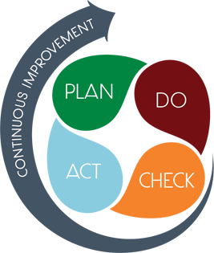
Connecting the Strategic plan & Continuous Improvement Plan
1.Increase student phonic awareness and create early readers
Increase student proficiency on ELA assessments by 3%
Milestones and MAP Scores
2. Increase student knowledge of new math standards
Increase student proficiency on Math assessments by 3%
Milestones and MAP Scores
Improve student attendance
Increase average attendance rate from 95% to96%
CCRPI Attendance Rate

Slide 25
Strategic Plan
Priority Ranking
Insert the school’s priorities from Higher to Lower
Higher
1.Increase student phonic awareness and create early readers
2 Increase student knowledge in numbers and operations domain
3. Increase student multiplication skills
4. Increase student attendance and decrease suspension rate
5.Increasing Teacher knowledge of Standards
6.Increase Teacher knowledge of IB Program
7. Improve stakeholder knowledge of school data and how to assist
8. Provide support to students and stakeholders in need
Lower

Slide 26
Guiding Question: After reviewing our current Strategic Plan and school KPIs, are there any additional goals we would like to include with our 2030 CIP Goals for the 2025-2030 Strategic Plan? (No more than 1-2 additional goals)
Enter any proposed additional goals for the strategic plan that the team identifies here.

Slide 27
Principal’s Report
West Manor currently 3rd in the state for Prodigy (Math Contest)
Mrs Walker named district team lead for IB10/8 Picture Day
10/09 Report Cards (push for infinite Campus)
10/10 SOTM
10/13-10/14 PD Days
10/22 Reading with Rari
10/23 Earthquake drill
10/24 Mass Vision screening
10/30 Fall Festival

Slide 28
Facilities Planning Update
REFINED SCENARIO: Re-purpose Peyton Forest ES Facility Improvements to Beecher Hills ES Realign boundaries for Beecher Hills, Miles, Peyton Forest, and West Manor
NEW IDEA with DEEPER INVESTMENT: Build NEW Middle School on Peyton Forest ES site Peyton Forest ES redistributed to Beecher Hills & West Manor (at Young MS Facility) West Manor ES moves to Young MS; Convert Young MS to West Manor ES

Slide 29



APS Forward 2040:
Reshaping the Future of Education
Taskforce Meetings
May 8, 2025 - Presentation
August 5, 2025- Presentation
Upcoming Public Meetings
October 20
November 10
Virtual – at Noon
In-person at 6PM at CLL (130 Trinity Ave)
UPDATE
Comprehensive Long-Range Facilities Plan
atlantapublicschools.us/APS2040
Notes:
Next on our agenda, we’d like to welcome our representative to the Long-Range Comprehensive Facilities Master Plan Taskforce. As many of you know, this taskforce plays a key role in shaping the future of our district’s facilities — ensuring they are aligned with projected enrollment, instructional needs, safety standards, and long-term community use."
Over the summer, the taskforce has been hard at work reviewing data, exploring options, and engaging in important planning conversations. [Name of Representative] will share an update on what’s been done so far, any key decisions or recommendations that have been made, and what’s ahead — including opportunities for the public to provide input.
[Allow the FMP representative to provide an update and answers questions. After this is concluded:]
Thank you [Name of Representative].
A report will be presented to the Board at its August 11 meeting, and the options will become public the week of August 18.
There are several upcoming public meetings where you can learn more and share your thoughts. The next public meetings are scheduled for: August 25, October 20, and November 10
On each date, there will be a virtual meeting at noon and an in-person meeting at the Central Office at 6PM.
I strongly encourage you all to attend these meetings. This is a critical time for public input, and your voice is essential.

Slide 30
Thank you

